Slide 1


Senior Design Project Review
AI System for Predicting Drug Combination Effects in Cancer Cells
SDP ID: 20250917
Presented By:
Name of the Student(s) with Regd. No.:
VENKATA SUHAS BODDU (22BCE8332)
SIRAMDASU LALITH KUMAR (22BCE9938)
NARU JYOTHIKA REDDY (22BCE8256)
SCOPE
VIT-AP University,
Amravati, India
1

Slide 2
Presentation Outline
Introduction
Project Overview and Problem Statement
Motivations
Background & Related Work/ Literature Review
Existing Solutions / Literature Survey
Gaps Identified / Improvements Over Existing Solutions
Project Objectives
Proposed Solution
System Architecture /Workflow Diagram /Model Diagram /Block Diagram/UML diagrams
Key Components/Features/Modules
Algorithms Used/Technologies, Frameworks, and Tools Used
Simulation and Results
Summary ( Findings, Limitations, Future Directions )
References
Notes:
2

Slide 3
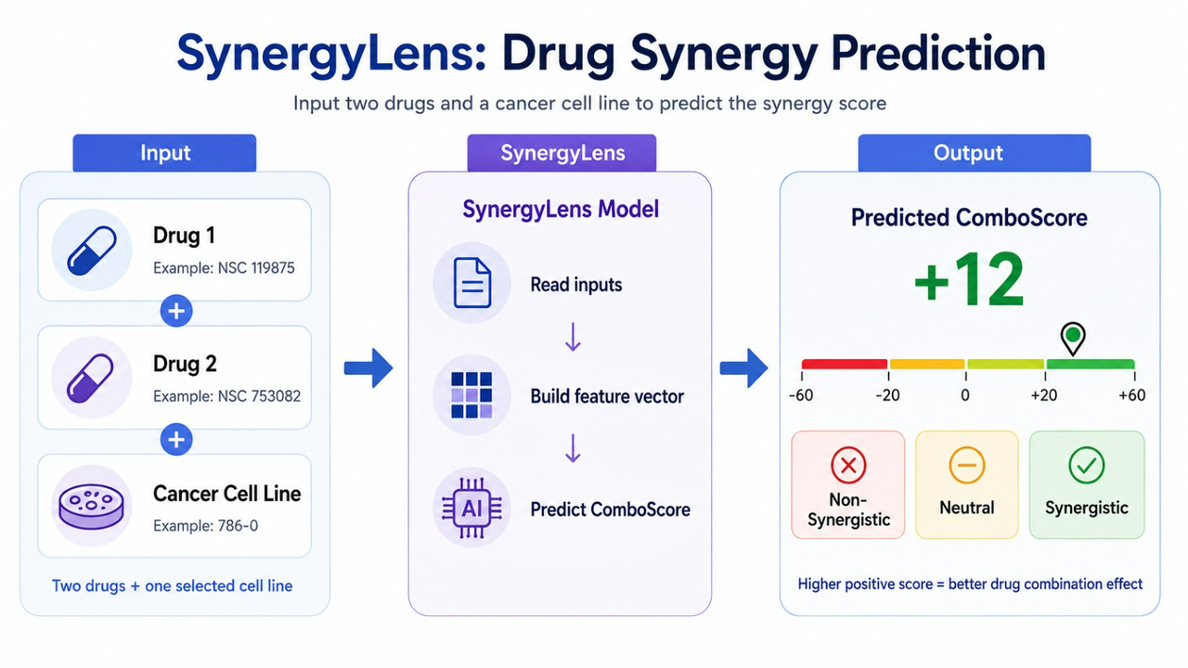
Introduction
Project Overview
Cancer is one of the most complex diseases, involving multiple biological pathways that control cell growth and survival, making treatment challenging.
To improve treatment effectiveness, researchers often use combinations of anti-cancer drugs instead of relying on a single drug. When two drugs work better together, the effect is called synergy, whereas interfering drug interactions are called antagonism.
However, experimentally testing thousands of possible drug combinations is expensive and time-consuming. To address this, SynergyLens uses machine learning and high-dimensional omics data to predict the ComboScore of drug pairs, supporting researchers in prioritizing potentially effective drug combinations for further experimental analysis.
2
Notes:
2

Slide 4
Introduction
Problem Statement
Identifying effective anti-cancer drug combinations is a major challenge due to the enormous number of possible drug pairs and the complex biological interactions across different cancer cell lines. Experimental evaluation of every combination is costly, time-consuming, and computationally impractical.
Most existing approaches focus only on classifying drug interactions as synergistic or antagonistic, while providing limited interpretability of the biological factors influencing predictions.
This project addresses these challenges by developing an interpretable machine learning framework that predicts continuous ComboScore values using high-dimensional cell line features and drug-related features, supporting efficient prioritisation of potentially effective drug combinations for further experimental analysis.
3
Notes:
2

Slide 5
Introduction
Motivations
Predicting effective drug combinations experimentally is expensive and time-consuming due to the enormous number of possible drug pairs.
High-dimensional omics and drug-related features can help machine learning models capture complex cancer–drug interactions more effectively.
SHAP-based explainability is used to understand the key biological and drug-related features influencing synergy predictions.
4
Notes:
2

Slide 6
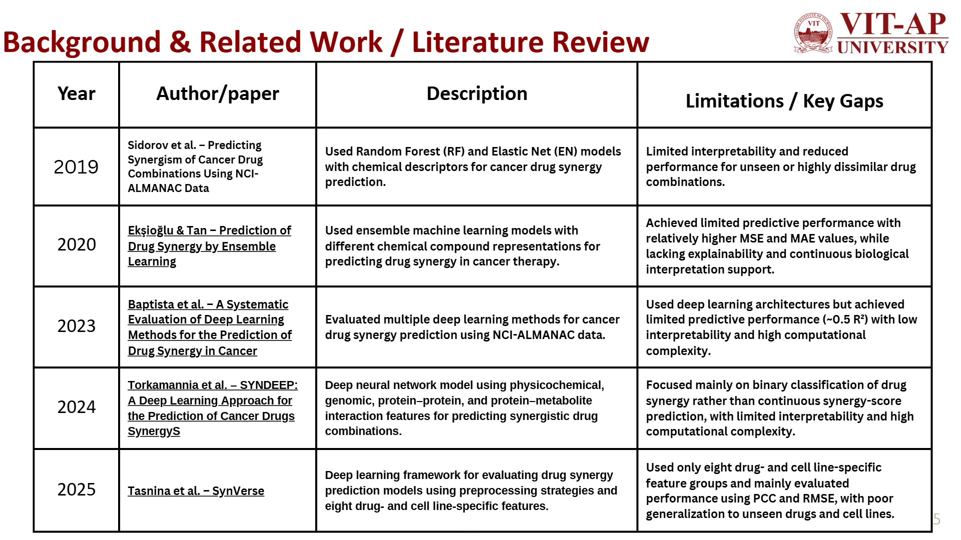
5

Slide 7
Background & Related Work / Literature Review
Gaps Identified / Improvements over Existing Solutions
Predicts continuous ComboScore values instead of only classifying combinations as synergistic or antagonistic.
Integrates SHAP-based explainability to identify important biological and drug-related features influencing predictions.
Uses a scalable ML pipeline for handling high-dimensional omics and drug-feature data efficiently.
Supports both single and batch prediction workflows for practical research usability.
Explores both classical and quantum machine learning approaches for complex biological data analysis.
6

Slide 8
Project Objectives
Predict drug-combination synergy for selected drug pairs across different cancer cell lines using machine learning.
Utilize high-dimensional biological and drug-related features to improve synergy prediction accuracy.
Provide interpretable predictions using SHAP to identify key features influencing drug synergy.
Support scalable screening through both single and batch prediction workflows.
Deliver an interactive web-based system with prediction, explainability, and drug-information support.
Improve transparency through system monitoring, validation, and model-performance insights.
Explore quantum machine learning approaches for handling complex high-dimensional biological data.
Support researchers in prioritizing potentially effective drug combinations for further experimental analysis.
7

Slide 9
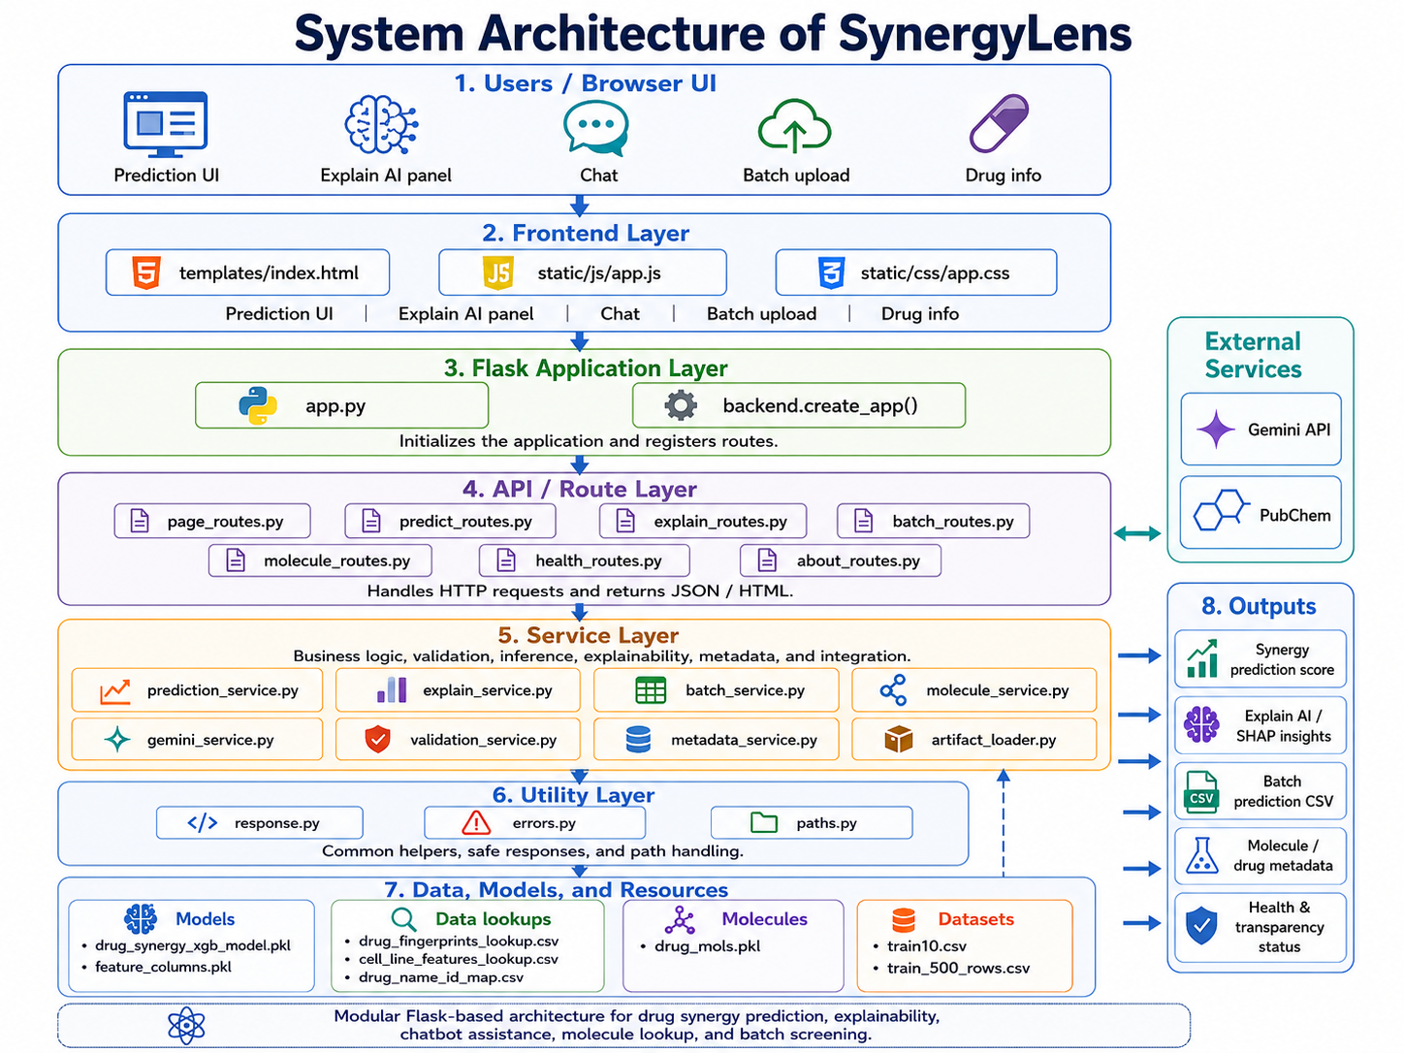
Proposed Solution
System Architecture
8

Slide 10
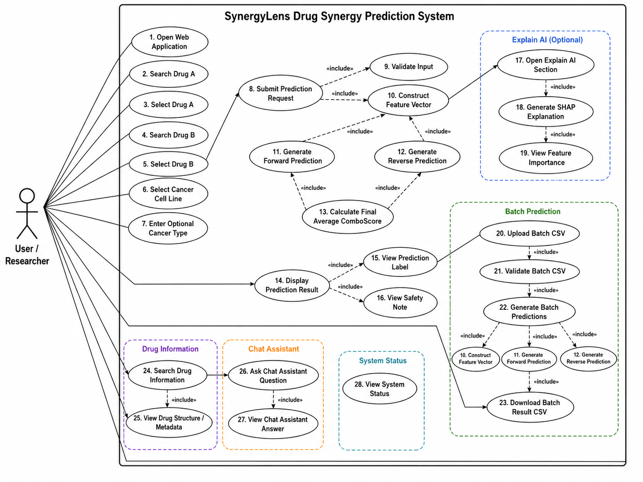
Proposed Solution
UML diagrams
9

Slide 11
Proposed Solution
Features
1.Prediction Model
XGBoost regression model
Handles high-dimensional tabular data
Predicts synergy score
Uses Quantum Kernel Ridge Regression (QKRR)
4. Interactive Web Interface
User-friendly interface (Flask-based)
Drug input, prediction, and visualisation
Batch processing + drug information
5. Conversational AI Assistant
Chatbot for natural-language queries
Uses SHAP-based context for grounded explanations
Supports in constructing answers
2. Shapley Additive Explanation (SHAP)
SHAP TreeExplainer
Identifies top contributing features
Provides human-readable explanations
3. Batch Prediction
Upload a CSV file with multiple drug pairs
System predicts synergy scores for all at once
Returns a downloadable results file
10

Slide 12
Proposed Solution
Algorithms Used
XGBoost Regressor → Final model used for continuous ComboScore prediction
Random Forest, CatBoost, LightGBM → Used for model comparison and performance evaluation
Quantum Kernel Ridge Regression (QKRR) → Experimental quantum model for handling high-dimensional biological data
Label Encoding → Encoding categorical cancer and cell-line information
Forward & Reverse Prediction Averaging → Final ComboScore calculation for drug-pair order consistency
Technologies & Frameworks
Python for backend and machine learning development
HTML, CSS, and JavaScript for frontend development
Flask for backend APIs and request handling
Pandas and NumPy for preprocessing and data handling
Scikit-learn and XGBoost for machine learning workflows
RDKit for drug molecular fingerprint generation
SHAP for model interpretability
Git and GitHub for version control and repository management
11

Slide 13
Proposed Solution
Development Tools
Google Colab and Jupyter Notebook for experimentation and model training
Visual Studio Code for application development
Git LFS for handling large model files
Python Virtual Environment for dependency management
PowerShell / Command Prompt for server and Git operations
System Modules
Validation Module for input verification
Feature Construction Module for generating model inputs
Prediction Module for ComboScore prediction
Explainability Module using SHAP
Batch Prediction Module for CSV-based predictions
Drug Information Module for metadata and structure information
Chat Assistant Module for user interaction and guidance
12

Slide 14
=
Simulation and Results
Dataset Overview (parameter Description)
Source: NCI ALMANAC Dataset
128,445 samples (drug pair × cell line combinations)
86 drugs, 38 cell lines, 9 cancer types
Each sample represents:
→ A drug pair tested on a specific cancer cell line
High-dimensional data: ~1160 features
Feature Group → What it describes → Why useful for synergy
─────────────────────────────────────────────────────────────────
DD (206) → Drug chemical structure → What the drug looks like chemically
DDP (157) → Drug pair pathway effect → How A+B together affect each pathway
CNV (157) → Gene copy numbers → How many copies of each gene
EXP (157) → Gene activity levels → Which pathways are switched on
Methy (157) → Gene silencing patterns → Which pathways are epigenetically off
Mut (157) → Gene mutations → Which genes are broken
RNAi (157) → Pathway dependencies → Which pathways cancer needs to survive
─────────────────────────────────────────────────────────────────
TOTAL: 1148 features + 12 meta = 1160 columns
13

Slide 15
Simulation and Results
Input – Output Descriptions
Batch Prediction & Workflow
Single Prediction Input
Batch Prediction
Drug 1 ID
Drug 2 ID
Cell Line
Optional: Cancer Type, Model Type
CSV upload containing multiple drug combinations (INPUT)
Required fields: Drug1 ID, Drug2 ID, Cell Line
Generates downloadable prediction results CSV (OUTPUT)
Prediction Output
Predicted ComboScore
Synergy Label
Synergistic
Neutral
Antagonistic
Forward & Reverse Prediction Scores
Drug and Cell-line Metadata
Normalized Input Details
Prediction Workflow
Input Drug Pair & Cell Line
→ Feature Lookup & Construction
→ Feature Alignment with Training Schema
→ Model Prediction
→ ComboScore Generation
→ SHAP-based Interpretation
14

Slide 16
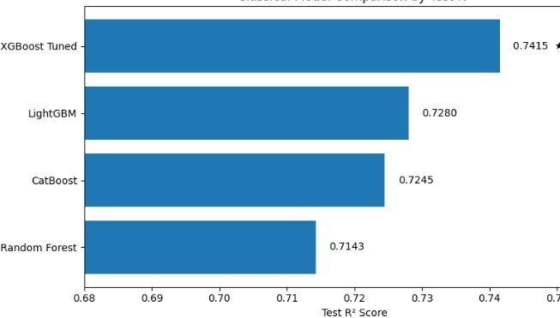
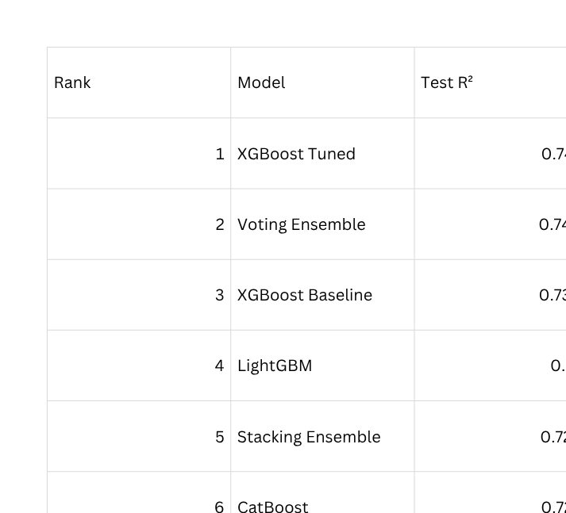
Simulation and Results
Implementation Outcomes ( Tables / Figures / User Interface Snaps)
Machine learning Model predictions
R square comparison
15

Slide 17
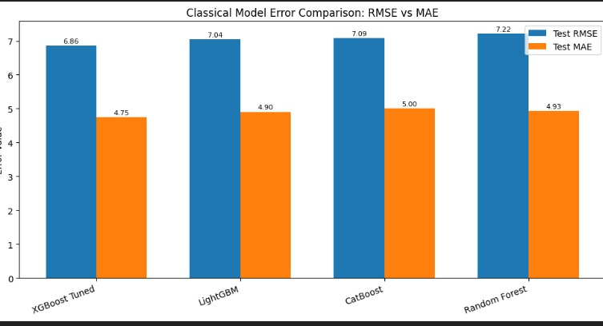
Simulation and Results
Implementation Outcomes ( Tables / Figures / User Interface Snaps)
Quantum Machine learning Model predictions
Model Used: Quantum Kernel Ridge Regression (QKRR)
R² Score: 0.5169
MAE: 4.0722
Classical Model Error Comparison: RMSE vs MAE
16

Slide 18
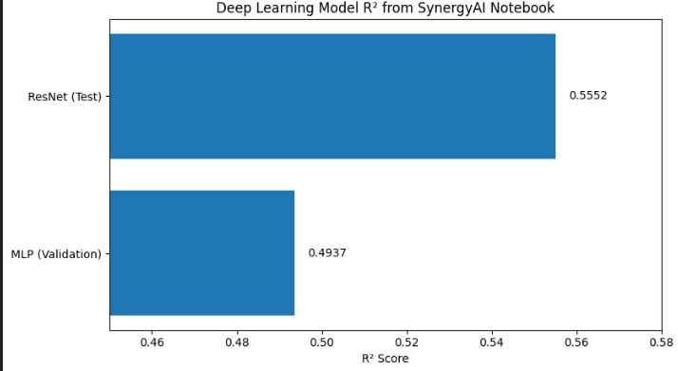
Simulation and Results
Implementation Outcomes ( Tables / Figures / User Interface Snaps)
The deep learning models show lower accuracy compared to the tuned XGBoost model. ResNet achieved an R² of 0.5552 and MLP achieved 0.4937, while XGBoost Tuned achieved a much higher R² of 0.7415, making XGBoost the best-performing model in this comparison.
17

Slide 19
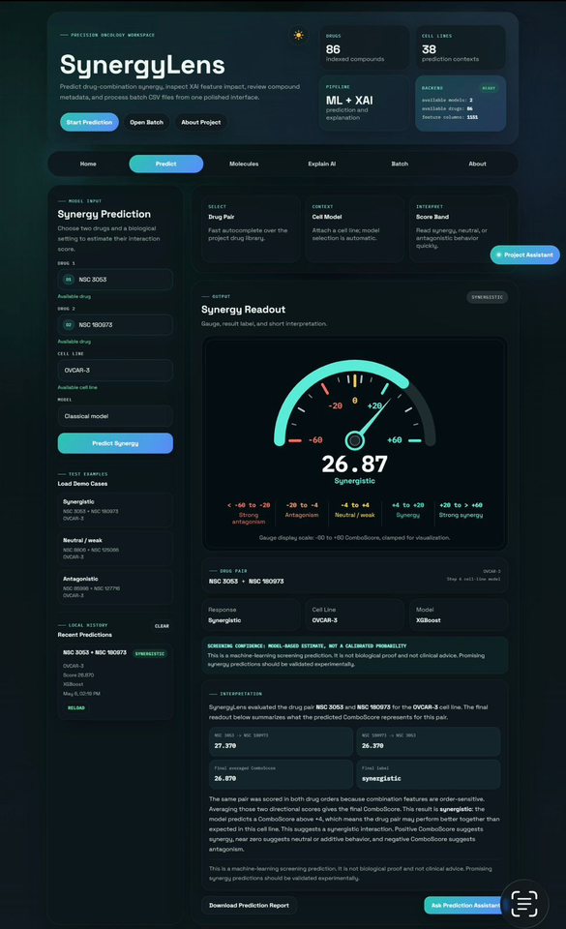
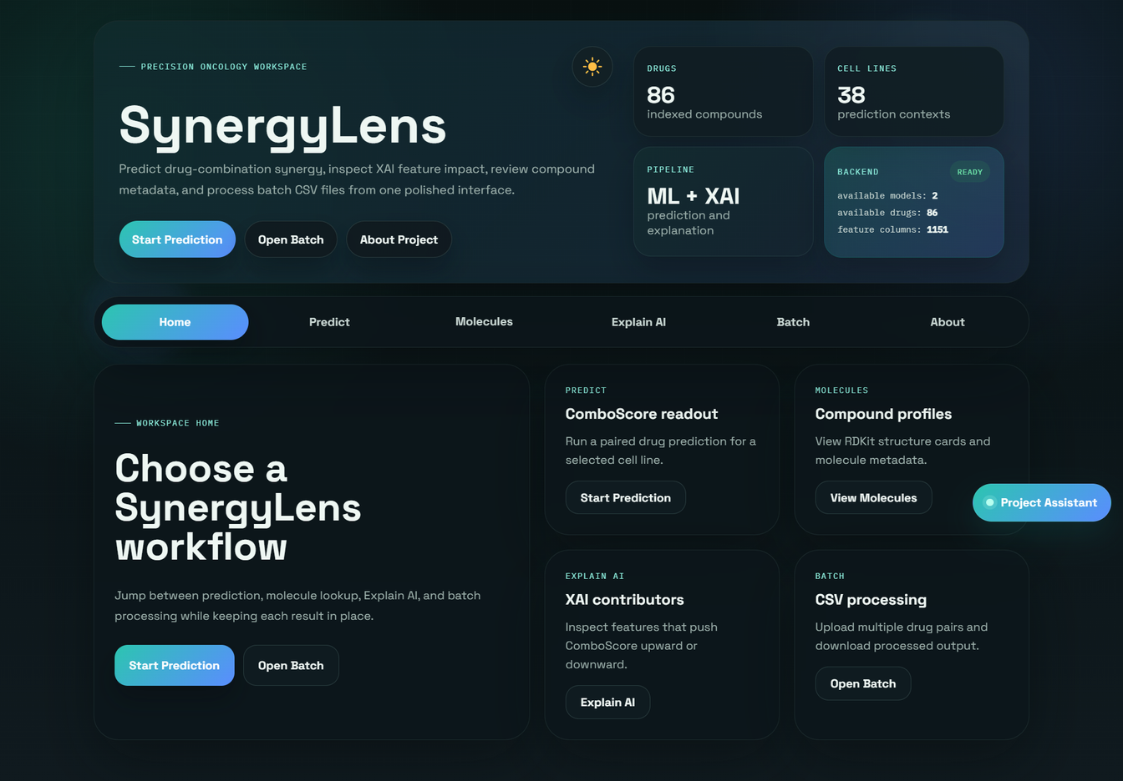
Simulation and Results
User Interface Snaps
Prediction
Home
18

Slide 20
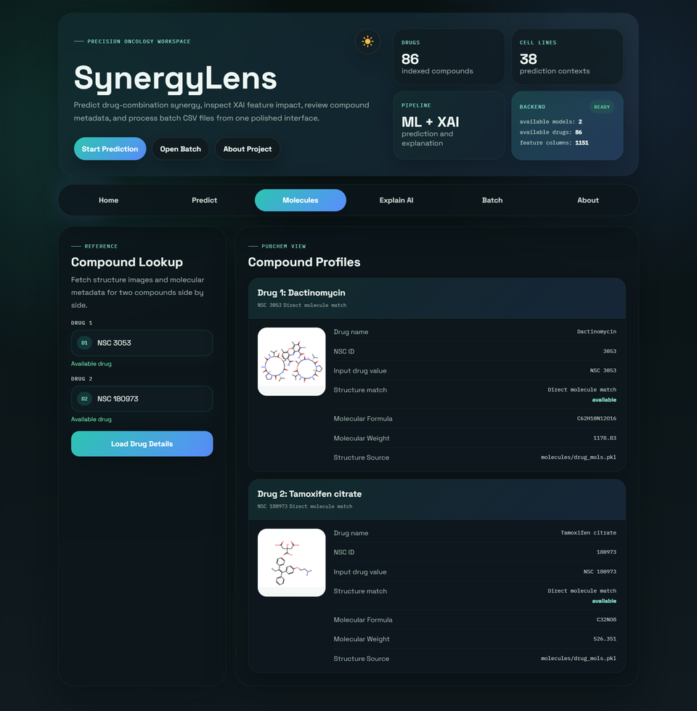
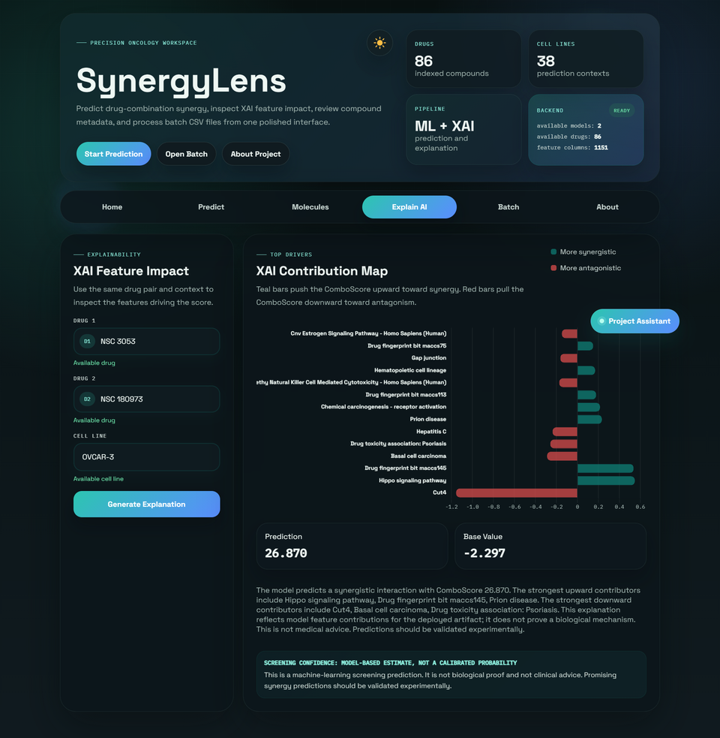
Simulation and Results
User Interface Snaps
Molecule structure representation
SHAP Feature
19

Slide 21
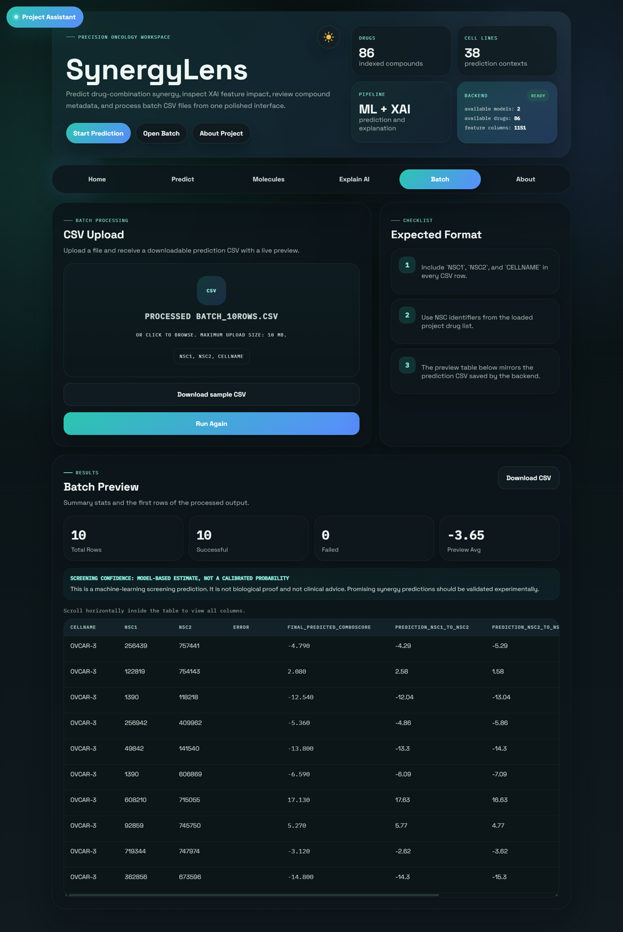
Simulation and Results
User Interface Snaps
Batch Prediction Feature
20

Slide 22
Summary
Key Findings
XGBoost achieved the best performance among the evaluated machine learning models for drug synergy prediction.
Drug-related toxicity and omics features showed strong influence on ComboScore prediction.
SHAP analysis successfully identified dominant biological and drug-related features affecting synergy outcomes.
Predicting continuous ComboScore provided more detailed insight compared to simple synergy classification.
The system successfully supported both single and batch prediction workflows through a deployable web interface.
Limitations
Model performance is limited by the availability and diversity of experimental drug-combination data.
Generalization to completely unseen drug pairs and rare cancer conditions remains challenging.
High-dimensional biological data increases computational complexity during training.
Quantum-model integration is still in the experimental stage and requires further optimization.
Predictions are research-supportive and not intended for direct clinical decision-making.
21
Notes:
14

Slide 23
Summary
Future Directions
Improve prediction accuracy using larger and more diverse biomedical datasets.
Explore advanced hybrid AI and quantum-enhanced learning approaches for high-dimensional biological data.
Integrate additional omics modalities and pathway-level biological information.
Extend the system toward personalized medicine and patient-specific drug synergy prediction.
Enhance explainability with deeper biological pathway interpretation and interactive visual analytics.
Deploy the system as a scalable cloud-based platform for real-time large-scale screening.
22
Notes:
14

Slide 24
References
[1] Chen, J. (2024). Prediction of cancer cell line-specific synergistic drug combinations based on multi-omics data [Data set]. Zenodo. https://doi.org/10.5281/zenodo.14552135.
[2] Hitesh, K., & P, V. P. (2025). Cancer cell detection using a hybrid quantum and classical machine learning model. In Proceedings of the 3rd International Conference on Futuristic Technology (INCOFT 2025) (Vol.2,pp.189–194). https://doi.org/10.5220/0013589100004664
[3] Jiang, Y., Chen, M., Xiong, Z., & Qin, Y. (2025). Predicting anti-cancer drug sensitivity through WRE-XGBoost algorithm with weighted feature selection. Genes & Diseases, 12, 101275. https://doi.org/10.1016/j.gendis.2024.101275
[4] Kumari, S., & Sheoran, R. K. (2025). Investigating the application of quantum machine learning in breast cancer management: A systematic study. Archives of BreastCancer. https://www.archbreastcancer.com/index.php/abc/upcoming/view/1060
[5] Ibrahim, S. P. S., Das, A., Gaurav, N., Mishra, L. P., & Kanyal, P. (2025). Healthcare analytics: Data mining techniques on electronic health records (EHR) to build a predictive model for early disease diagnosis. Proceedings of the 2025 International Conference on Sustainable Communication Networks and Application (ICSCN), 1618–1625. https://doi.org/10.1109/ICSCN67106.2025.11308699
23

Slide 25

24

